Slide 1
2016 PTA Reflections Contest
Theme: “What’s your story”

Slide 2
1st grade

Slide 3
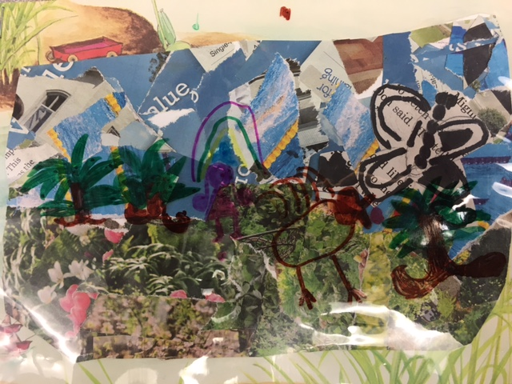
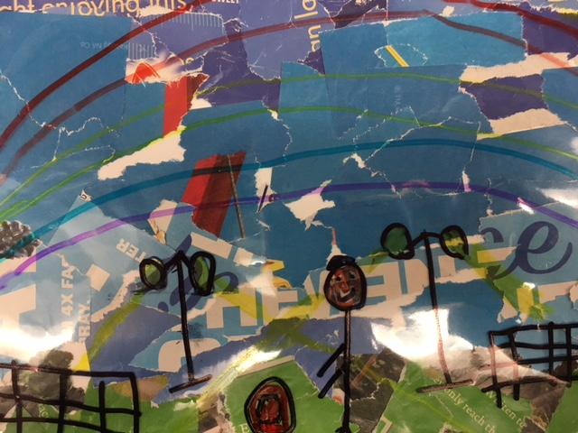
Honorable mention
Nevaeh Valdes-Doremus Joaquin Minos-Horne

Slide 4
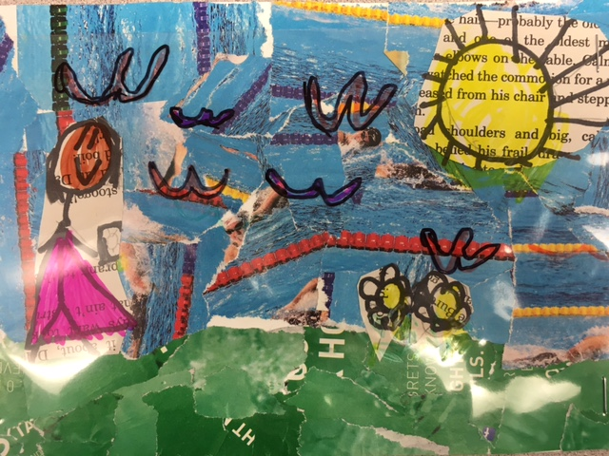
3rd Place
Annabelle Estremera
Horne

Slide 5
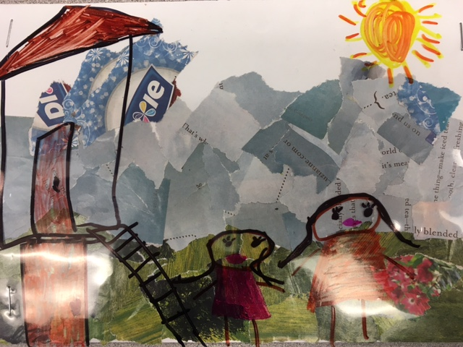
2nd Place
Ryann Taggett
Delcastillo

Slide 6
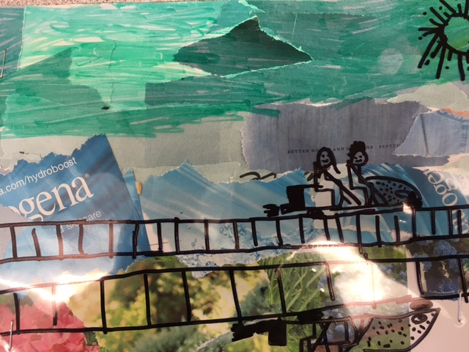
1st Place
Hudson Darnell
Delcastillo

Slide 7
2nd grade

Slide 8
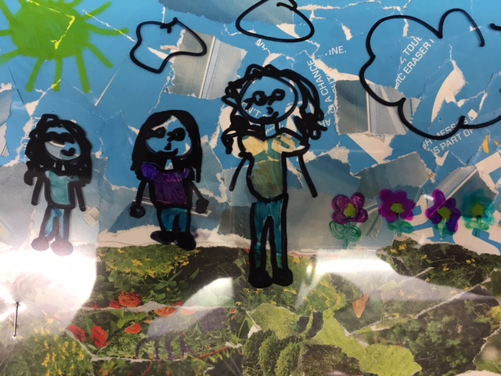
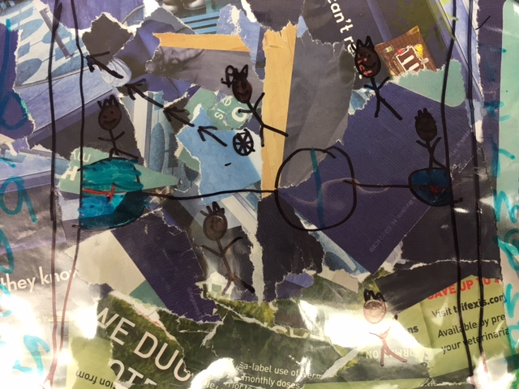
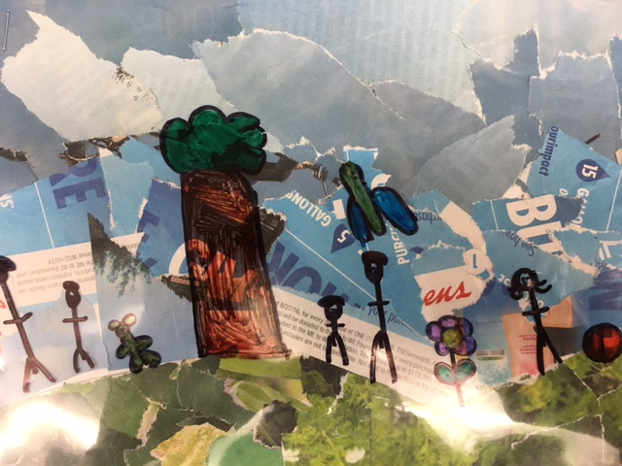
Honorable mention
Emily Munoz-Price Pilar Amador-Price Jack Mueller- Underwood

Slide 9
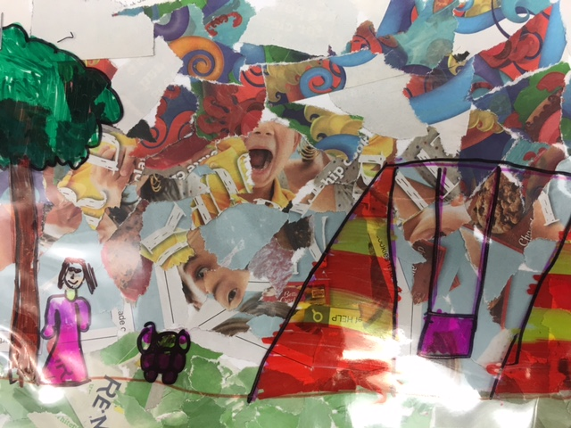
3rd Place
Sophia Zheng
Underwood

Slide 10
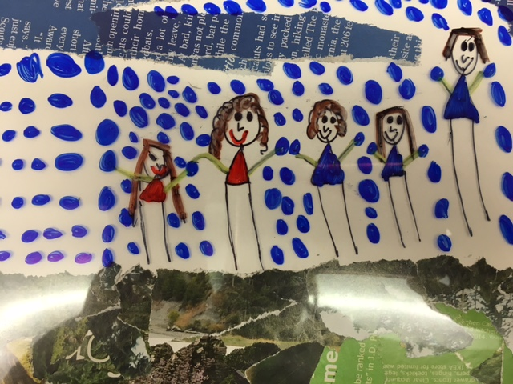
2nd Place
Kayla Deveney
Price

Slide 11
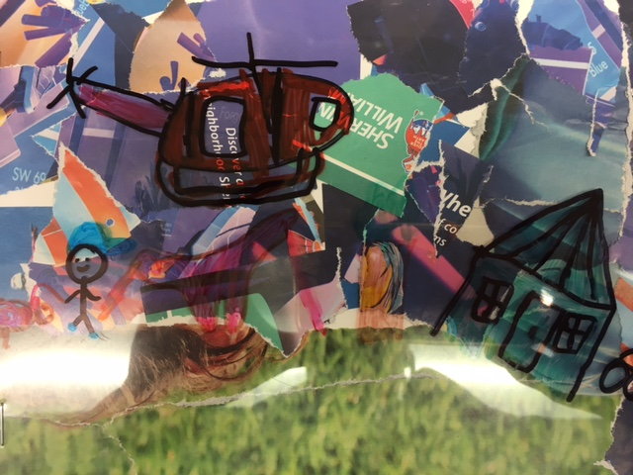
1st Place
AJ Boileau
Price

Slide 12
3rd grade

Slide 13
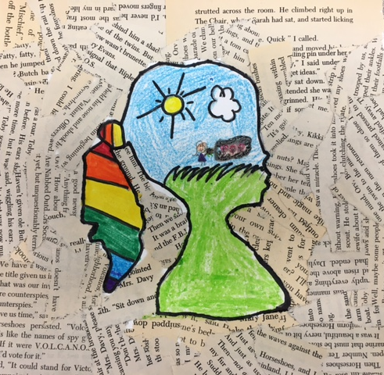
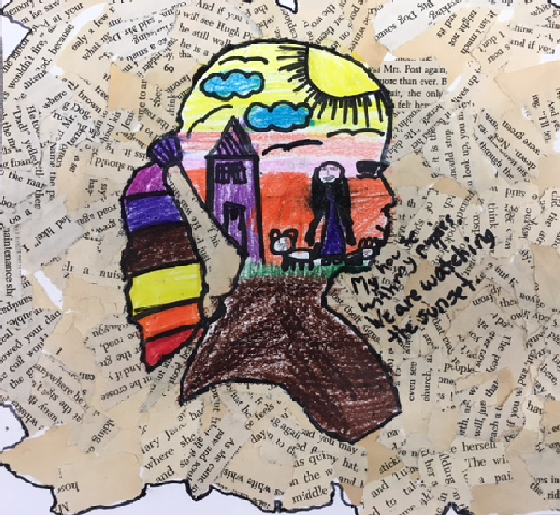
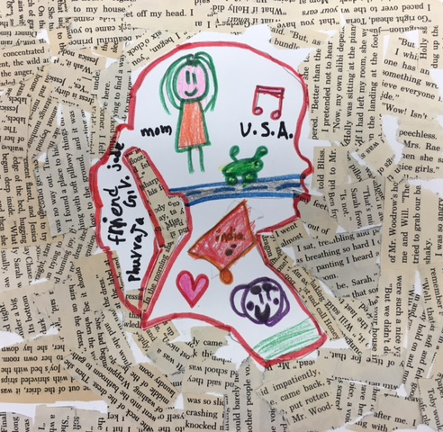
Honorable mention
Miley Robins-Scofield Isabella Zerrate-Janasiewicz Phurvaja Gopinath-Oliva

Slide 14
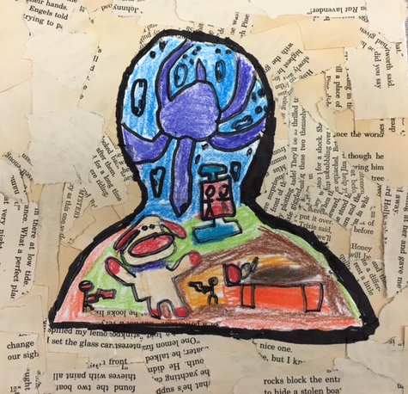
3rd Place
Austin Bonner
Janasiewicz

Slide 15
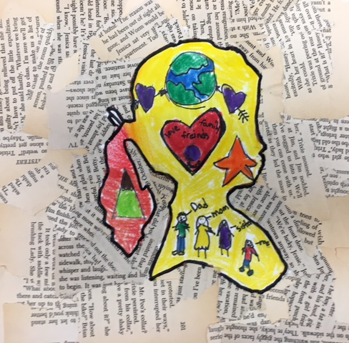
2nd Place
Veronica Torres
Scofield

Slide 16
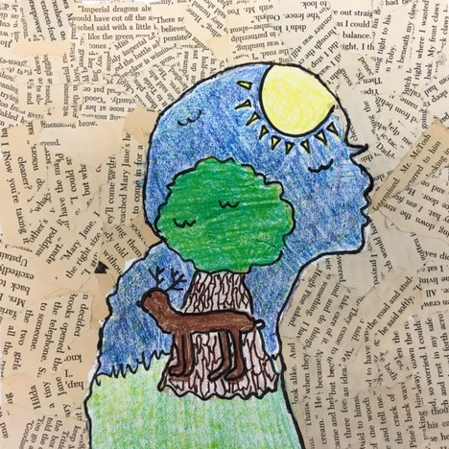
1st Place
Tiara Schwendeman
Scofield

Slide 17
4th grade

Slide 18
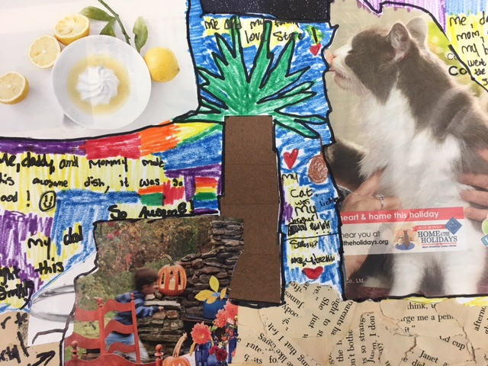
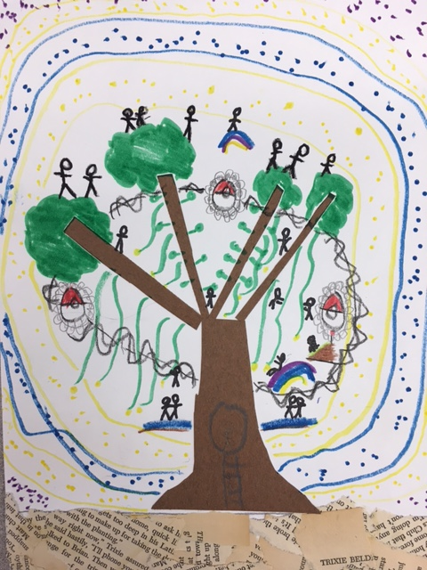
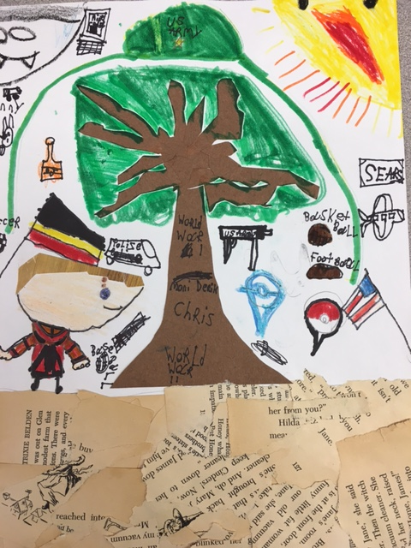
Honorable mention
Simrah Fahimuddin Roman Griffin Christopher Sears
Ritter Dickens Dickens

Slide 19
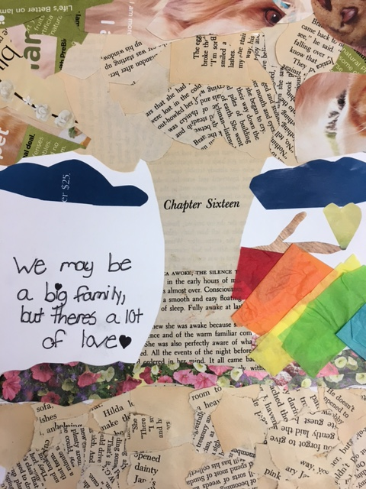
3rd Place
Emalyse Carpena
Dickens

Slide 20
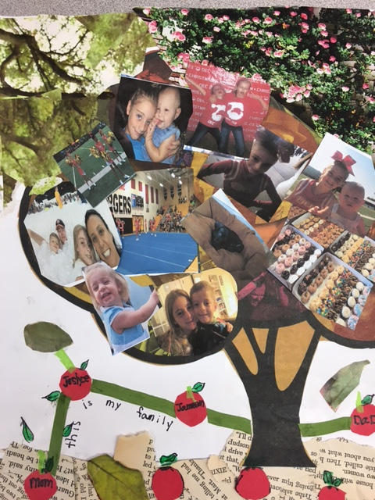
2nd Place
Justyce Delaney
Lanier

Slide 21
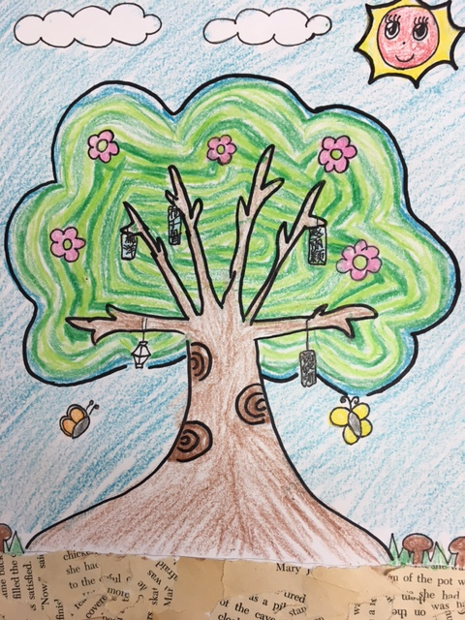
1st Place
Selina Yang
Dickens

Slide 22
5th grade

Slide 23
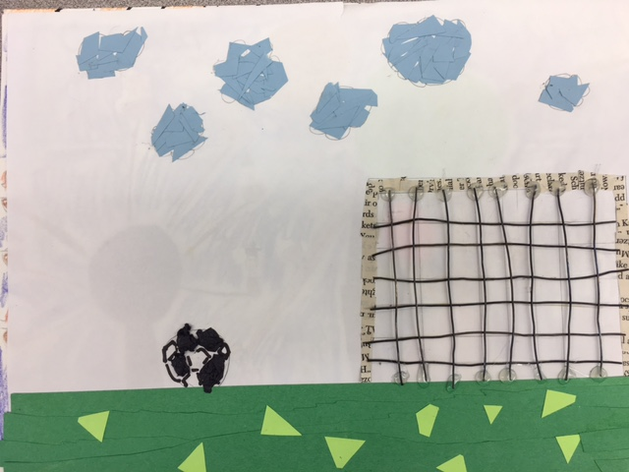
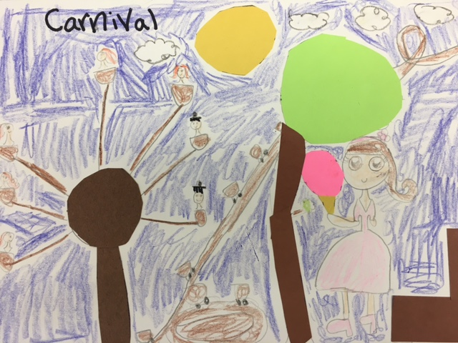
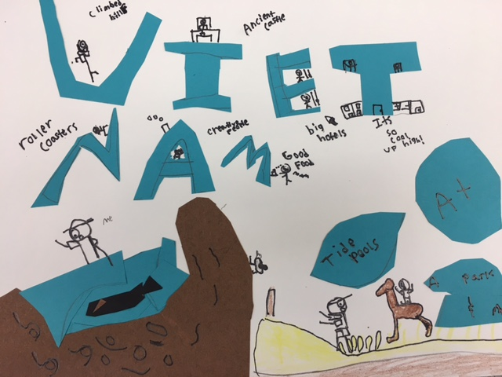
Honorable mention
Brady Stemac Casey Kyres Kaden Duong
Webber Webber Neukamm

Slide 24
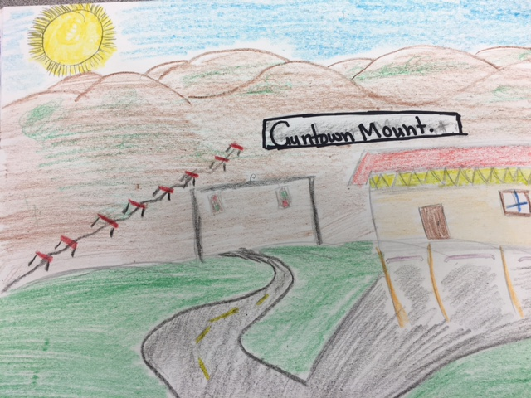
3rd Place
Lilly Lee
Neukamm

Slide 25
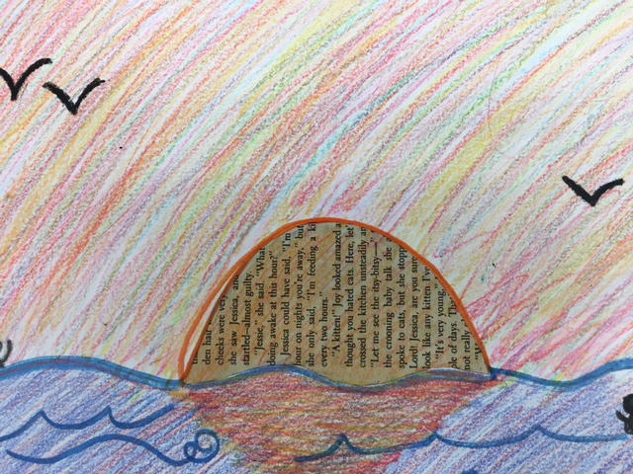
2nd Place
Sydney Mueller
Neukamm

Slide 26
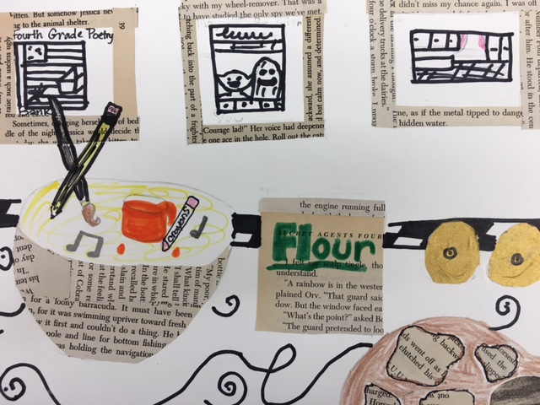
1st Place
Sydney Nichols
Webber

Slide 27
Congratulations grady tigers!!!!!

Slide 28
Special Thanks to:
All Participants
Grady PTA Merrilee Weinman, Judge

